Slide 1

Health Care-EDA
Neethu Sunitha Pradeepan

Slide 2
Business Understanding
The dataset is about health care sector
EDA is used to analyze the patients who are likely to show up for the actual scheduled appointment date
EDA is used to get meaning insights from the data given and proving recommendations.

Slide 3

Target Variable
Data is highly imbalanced with a ratio of 80:20
Patient No-show is the target variable considered in this analysis
We need to analyze the data with other features while taking target values separately to get some insights
In depth univariate and bivariate analysis has been performed to get meaningful insights

Slide 4

Univariate Analysis

Slide 5
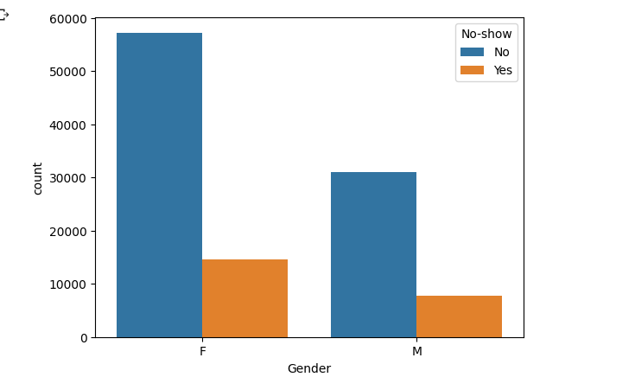
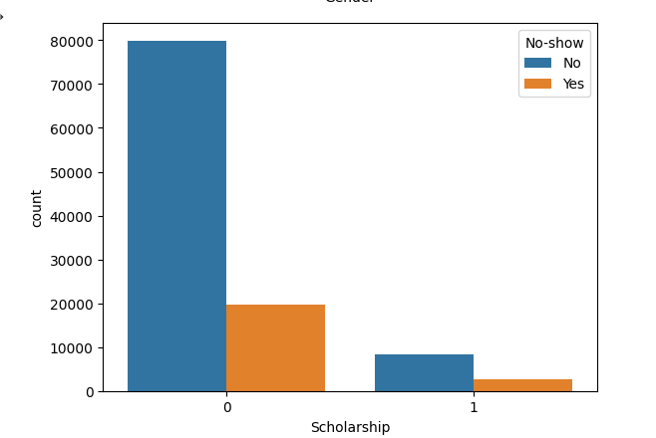
Insights
Male patients(19.98) seems to be showing up for the appointment more than female patients(~20.31)
Patients who have scholarship are less likely to show up with percentage of (23.73)

Slide 6
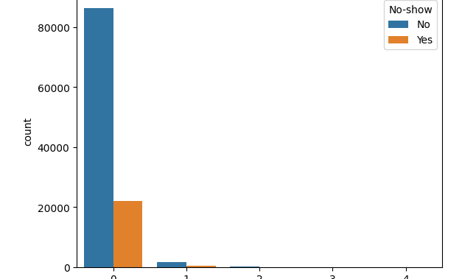
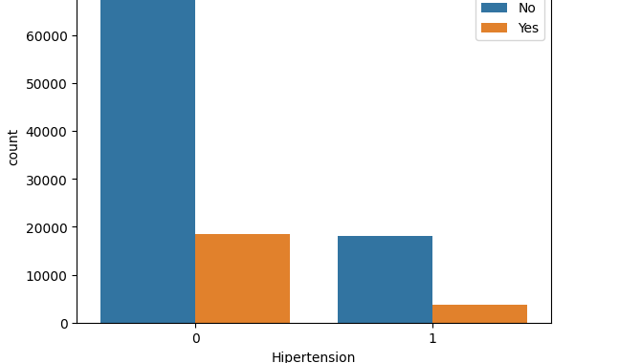
Insights
Handicap patients with handicap range of 4 are more likely not show up with percentage of 33.33 and handicap of range of 3 also have less chance to show up for the appointment with 23%
Patients who are hypertense (17.30)are more likely to show up than without hypertension (20.90)

Slide 7
Insights
Diabetic patients are more likely to show up with percentage of (18%) than non -diabetic(20.36)
Alcoholic and nonalcoholic patients are almost equally likely to show up with alcoholic patients(20.14) and non-alcoholic (20.19)
Patients of age group 109-120 (senior citizens ) are more likely not show up for the appointment with percentage of 60%
Also, teenage group in between age of 13-24 are also less likely to show up with percentage of 25.62

Slide 8
Bivariate Analysis

Slide 9
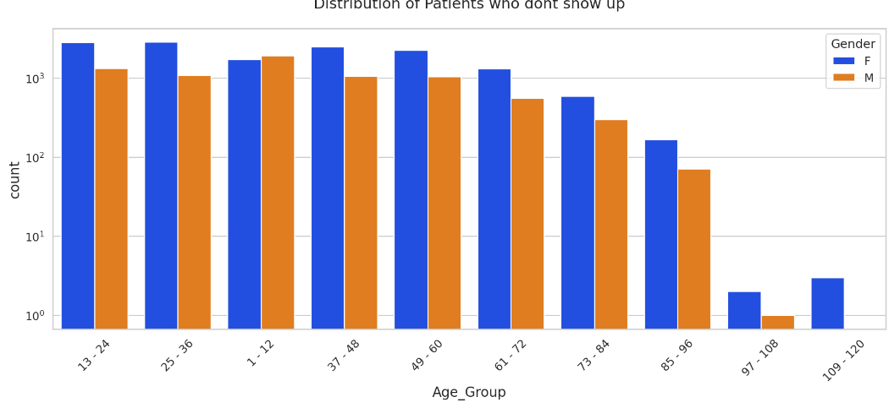
Insights
Senior citizen who are females at the age group 109-120 are less likely to show up than male senior citizens

Slide 10
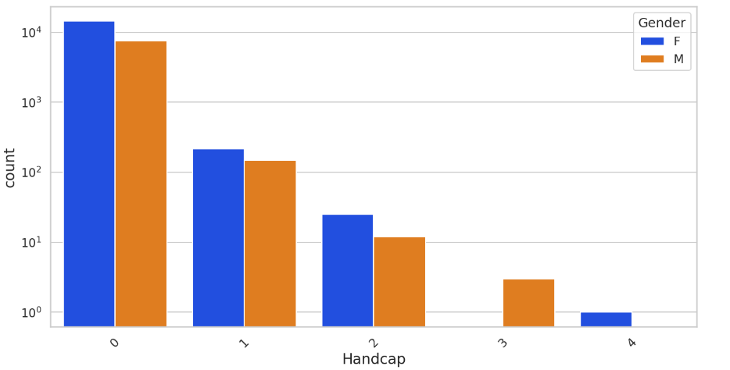
Insights
Female who are handicapped in the range of 4 seems to show up less likely than with male's handicap of range 4

Slide 11
Insights
Males who do have scholarship are more likely to show up than females who have scholarship
Females who are alcoholic are having less chance to show up than their counterparts
Female-Nondiabetic patients are less likely to show up than male-nondiabetic patients
Not-hypertense females are less likely to show up than male not -hypertense
Text received females less likely to show up than text received males

Slide 12

Thank you

